Slide 1
Selecting Herd Bull
Beef Production Game

Slide 2
What is the job of our bull?
Produce sperm
Pass on quality genetics of rate of gain, muscling, structure
Physically mount female

Slide 3
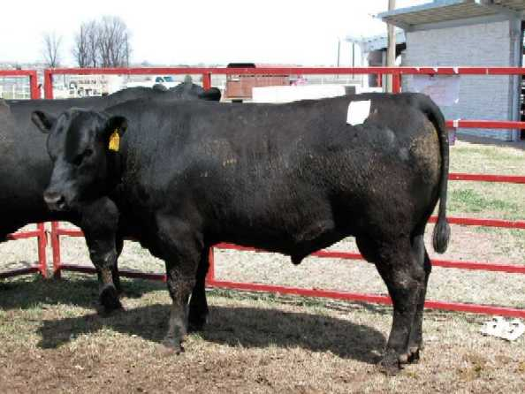
What do you look for in an ideal bull?
Structural Correctness
  Balance
  Correct set to feet and legs
Muscling
  Wide, deep quarter
  Wide chest floor
  Strong in the loin
Testicle Size
  Large scrotal circumference
Masculinity
  Thick through neck
  “Looks Like a Bull”

Slide 4
Using Expected Progeny Differences (EPDs)

Slide 5
What is a EPD?
EPD are genetic predictions of the quality of the offspring
We use
  Birth Weight BW (want low – easy calving)
  Weaning Weight WW (want high – fast growing)
  Yearling Weight YW (want high – fast growing)
  Maternal Milk MM (want high – produce a lot of milk)

Slide 6
Rank these Shorthorn bulls to be used on purebred Shorthorn cows and heifers. This operation retains the top 25% of their heifer crop as replacements, sells the middle 50% to other Shorthorn Breeders and sells the lower 25% as well as all male progeny at weaning. Feed is plentiful, labor is less than average.
Bull # | BW | WW | MM | YW
1 | 3.2 | 23 | 12 | 36
2 | -1.6 | 21 | 11 | 32
3 | 1.9 | 19 | 16 | 30
4 | 2.5 | 25 | 9 | 40

Slide 7
Placings
Official Placing: 2341
The most balanced bull on paper is probably #2. We would like to see his milk higher, but we need more growth than what #3 gives us and the other bulls are essentially to close to call for an advantage in milk. #4 is our high growth bull, but we definitely need more milk to go with him and his birth weight could be lower. #1 is way too high on birth and he doesn’t give us enough growth beyond gestation.

Slide 8
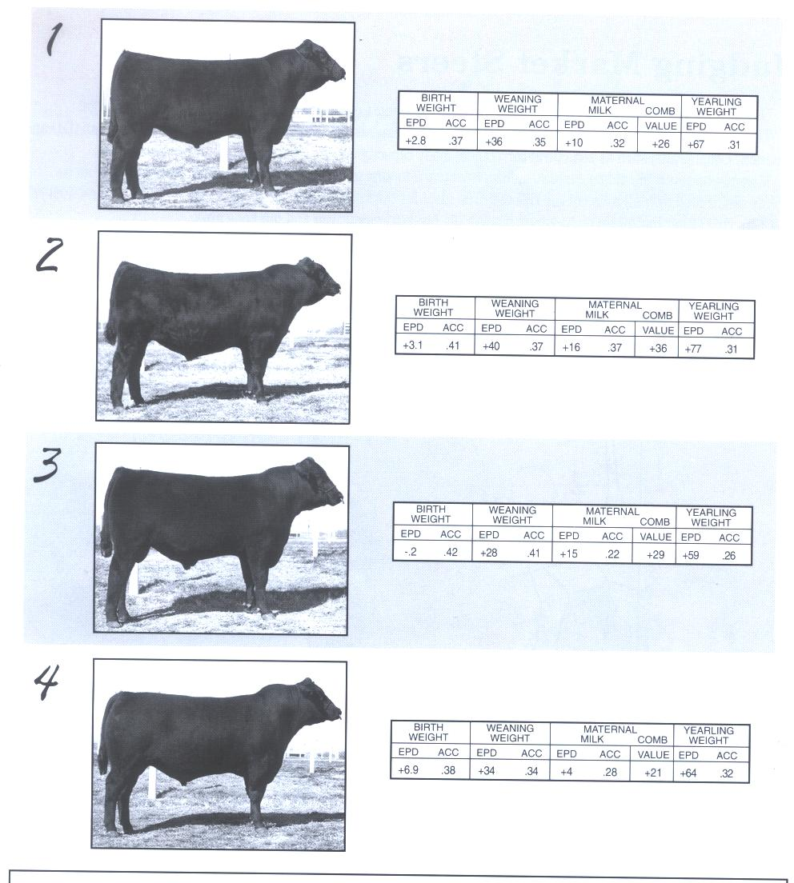
Select these bulls as they will be mated to both heifers and mature cows in a purebred operation. This operation profits primarily through the sale of yearling bulls to commercial producers. Each year they retain the top 50% of heifers as replacements. Feed and labor resources are average.

Slide 9
Correct Placings
Correct Placing – 2134
Cuts – 254
2 – long bodied, muscular, best EPD
1 – nicer balanced
3 - coarse fronted, short bodied
4 – high BW

Slide 10
Selecting the Bull for Your Farm
Beef Production Game
Select 1 bull, write down the number as well as the price

Slide 11
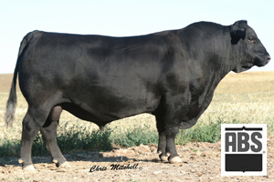

1 – Angus ($2850)

Slide 12
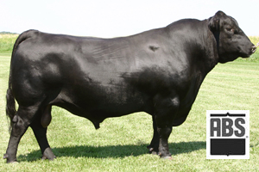

2 – Angus ($3150)

Slide 13
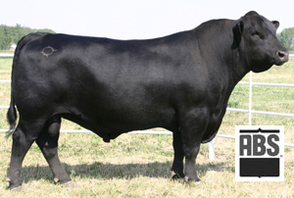

3 – Angus ($3750)

Slide 14
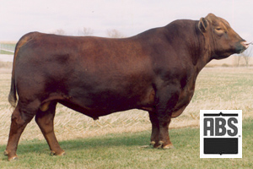

4 – Red Angus ($3150)

Slide 15
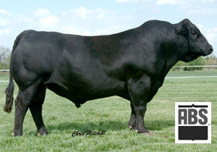

5 – Gelbvieh ($2250)

Slide 16
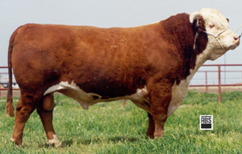

6 – Hereford ($2550)

Slide 17
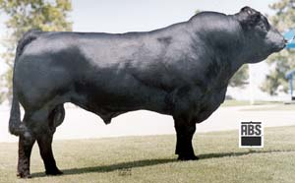

7 – Limousin ($3450)

Slide 18
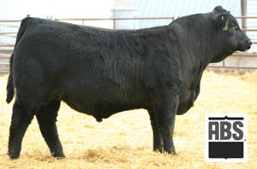

8 – Simmental ($3000)

Slide 19
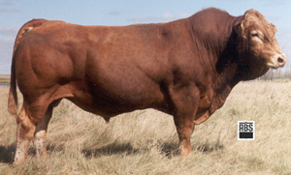

9 – Gelhvieh ($3300)

Slide 20
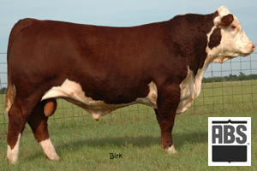

10 – Hereford ($3450)

